Slide 1

3D PRINTING AND ELECTRONICS
Team EverythingIsAwesome

Slide 2
Introduction
Application to Visualise CPU usage
Used 3D printing
Used User Friendly Electronics

Slide 3
Demo

Slide 4
User Testing
Tested on part IV peers
Asked them to read the meter and guess the value
Users were within 5% of the actual value on average

Slide 5
Motivation
Hard to view CPU usage with full screen applications
Prove that 3D printing doesn't require expertise
Prove that specialist education is not necessary to use electronics

Slide 6
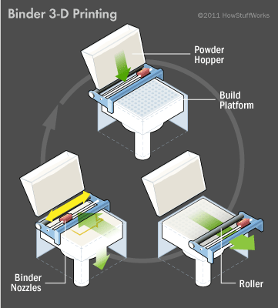
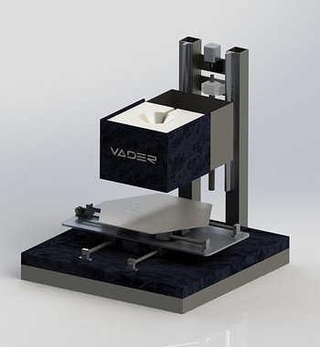
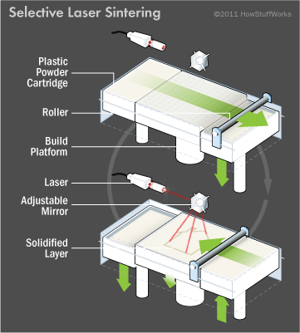
3D Printing
Three main types of 3D printing
Binder printing
Direct
Photoploymerization

Slide 7
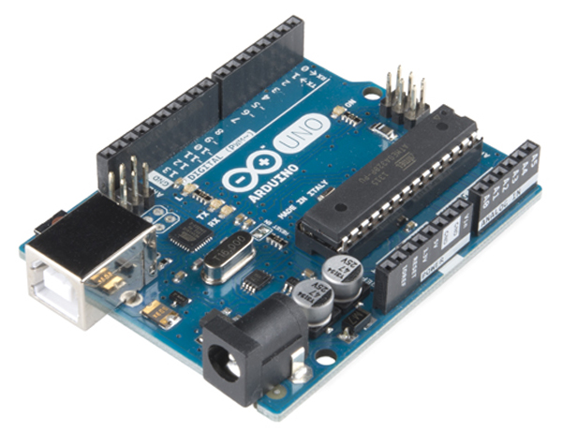
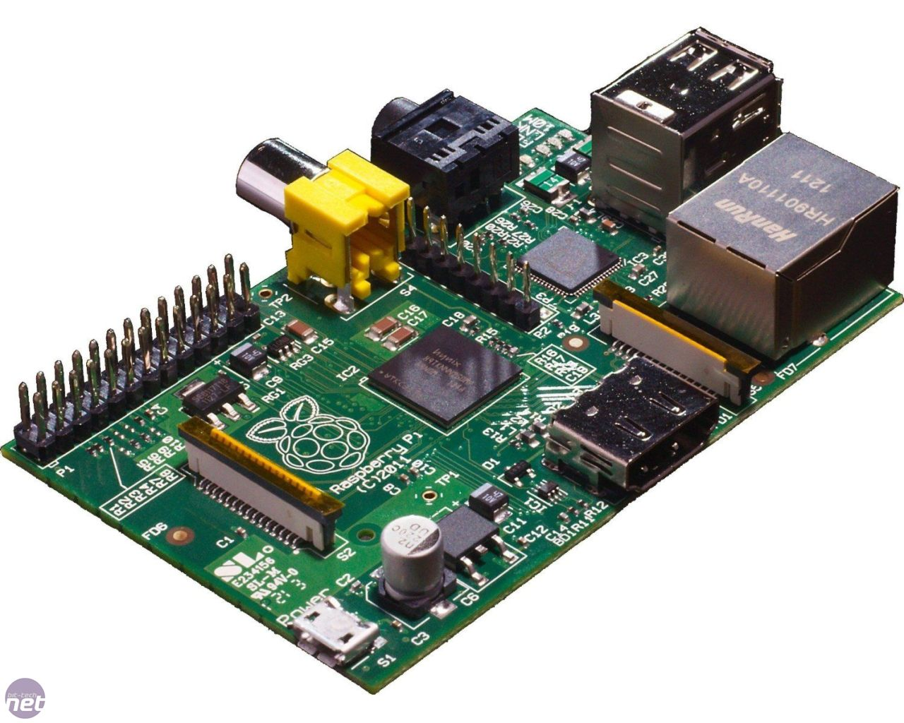
Electrical Design
Made use of readily available consumer development tools
Choice between Arduino and Rasberry Pi

Slide 8
Software Design
Should be transferable across different operating systems
Ideally make use of pre made serial libraries

Slide 9
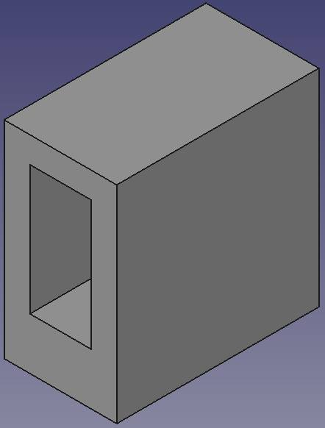
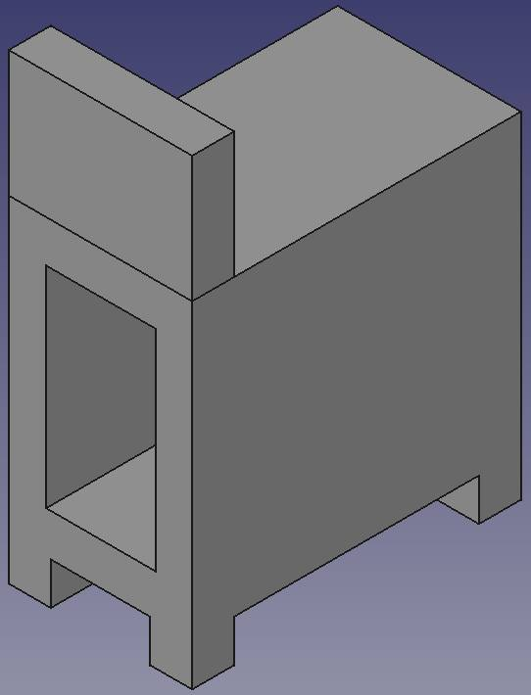
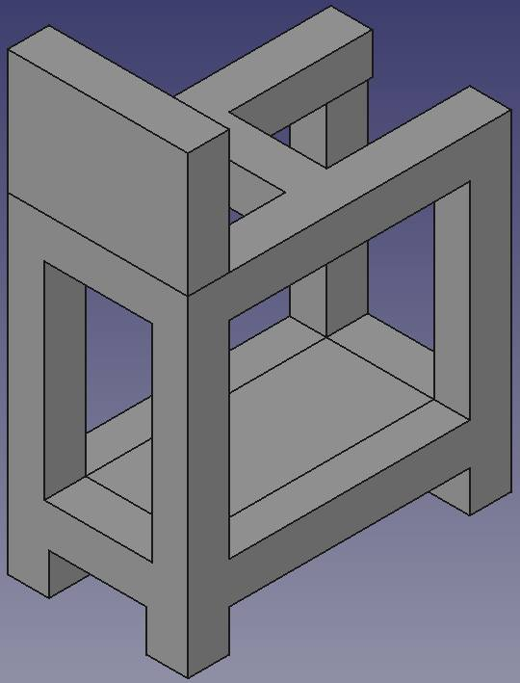
Housing Design

Slide 10
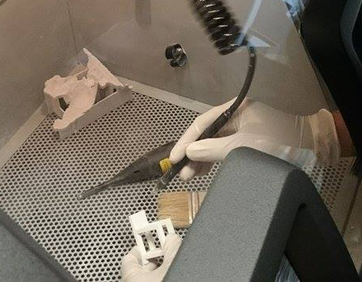
Implementation
Python to read CPU usage
Push data to Serial Buffer
Consumed by Arduino
Internal logic to drive Servo using I2C

Slide 11
Limitations
Learn to use CAD software
Learn to program electronics
Learn the capabilities of 3D printing
Cheap electronics
Not very accurate
Tends to overheat

Slide 12
Future Work
Array of Servos to show different statuses
Better quality hardware
Smoothing of movement
Visualizing non-numerical values
Use a Raspberry Pi
Feed your cat
User a Lightblue Bean
Use sensors

Slide 13
Conclusions
Showed that 3d printed objects can be used to visualise the status of a computer
Showed that electronics and 3d printing is doable
Showed that electronics and 3d printing are combinable

